Slide 1
Motion Intention Detection for functional reaching and placing tasks:
The subject will be instructed to move the object between 6 distinct positions
Each motion repeated to build a large dataset
Sensors: EMG, IMU, pressure sensor (positioned on finger)
From this dataset the following actions can be classified:
Reaching 6 different positions
Grasping object
Moving between positions
Objectives:
Classify tasks

Slide 2
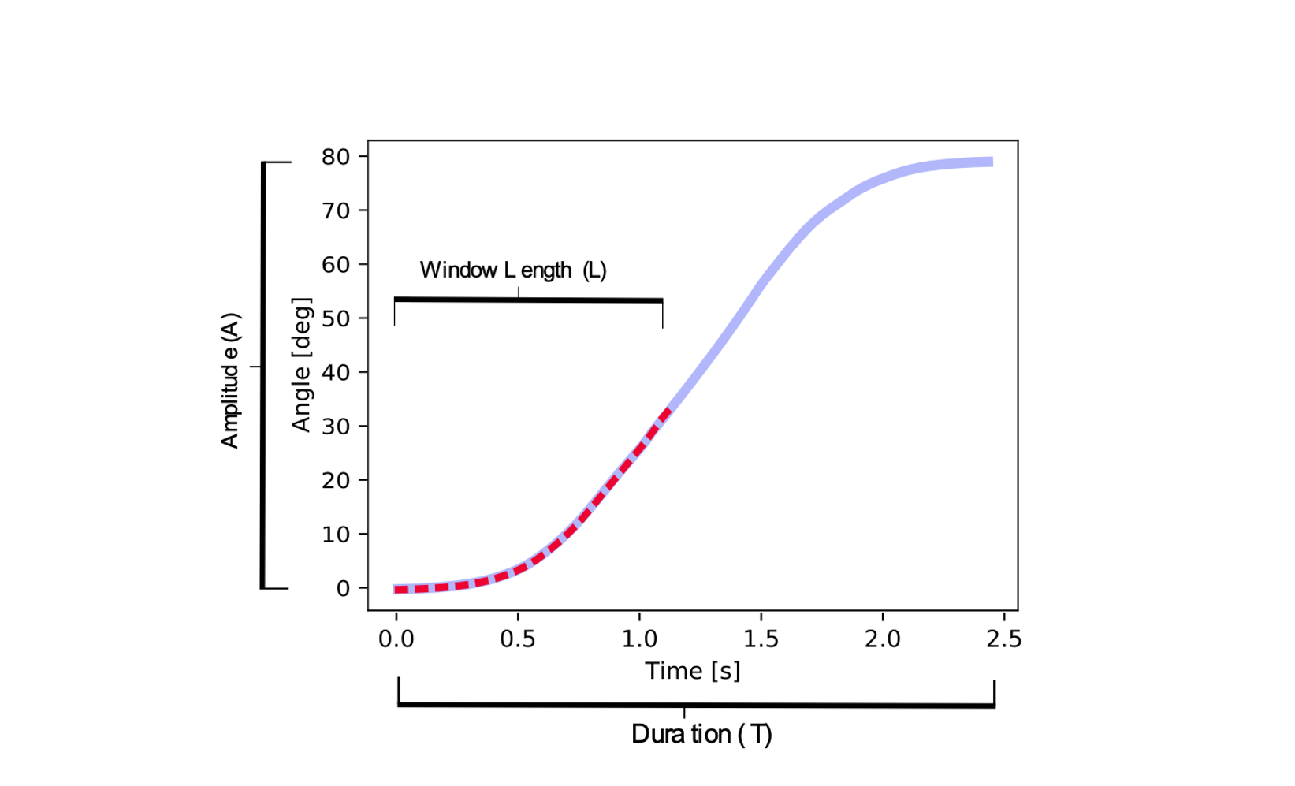

Slide 3
Reaching
frequency
time

Slide 4
EMG difference LRC (cut-off = 1.6s)

Slide 5
Kinematics difference LRC (cut-off = 1.6s)

Slide 6
EMG difference FB (cut-off = 1.6s)

Slide 7
Kinematics difference FB (cut-off = 1.6s)

Slide 8
Reaching (cut-off =1.4s, cv=10)
Before hyper-parameter tuning

Slide 9
Train-Test-Split
20%
30%

Slide 10
After hyper parameter tuning (T = 0.5)
Algorithm | Test size 33% | Test size 20%
Extra Trees | 0.78 | 0.79
Random Forest | 0.79 | 0.81
Gradient Boosting | 0.8 | 0.79
Ensemble | 0.73 | 0.70

Slide 11
After hyper parameter tuning (cv=10)
Algorithm | T=1.4 | T = 0.5 | T=0.3
Extra Trees | 0.78 | 0.79 | 0.79
Random Forest | 0.81 | 0.81 | 0.81
Gradient Boosting | 0.79 | 0.79 | 0.80
Ensemble (Test Score) | 0.73 | 0.70 | 0.70

Slide 13
Time Prediction

Slide 14
Placing: Time window= 0.7s

Slide 15
Kinematic difference FB change (cut-off =0.8s)

Slide 16
EMG difference FB change (cut-off =0.8s)

Slide 17
Placing (cut-off = 0.7)

Slide 18
Test = 33%
Algorithm | T=0.7 | T=0.2
Extra Trees | 0.83 | 0.66
Random Forest | 0.82 | 0.69
Gradient Boosting | 0.82 | 0.68
Ensemble | 0.84 | 0.58

Slide 19
Test = 20%
Algorithm | T=0.7 | T=0.3 | T=0.2
Extra Trees | 0.89 | 0.76 | 0.72
Random Forest | 0.89 | 0.78 | 0.74
Gradient Boosting | 0.87 | 0.71 | 0.68
Ensemble | 0.71 | 0.54 | 0.59

Slide 21
Time Prediction

Slide 22
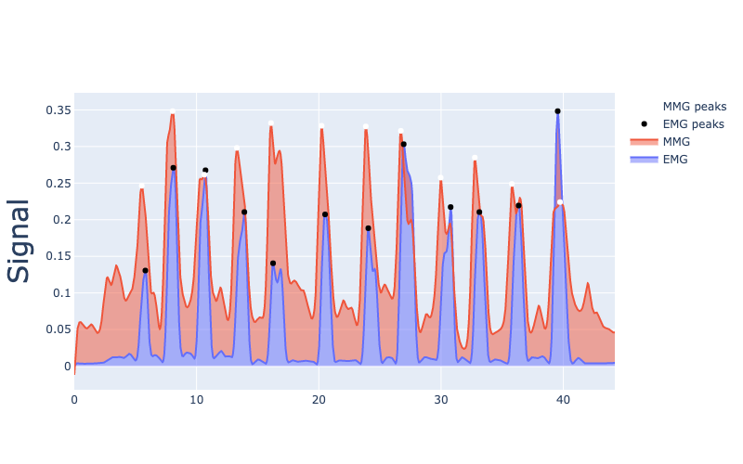
MMG/EMG
Mean change in peak: 0.29s (MMG faster than EMG)
Uncorrelated signals
time

Slide 23
Speech
Speech tagging: target verbs (commands)
Sentiment analysis: emotion of patient
Need to generate dataset for sentiment analysis
Already have code for google API and also buzzword
Text or audio?
EDGAR

Slide 24
Visual
Yolo algorithm: real-time object detection
Training for objects used in activities of daily living
Environment sensing
Depth sensor with IMU

Slide 25
To do
IRB
TD

Slide 26
Next experiment
Forward kinematics?
Otherwise: train with robot and use LSTM for planar position
Or use motion capture for real position

